Slide 1
Deep Learning Algorithms in Image Recognition
Guided by:
Dr. PRAKASH MANI
SCHOOL OF ADVANCE SCIENCE
VIT
VARUN PAANDIAN M – 21MDT0141
POOJA K-21MDT0140

Slide 2
ABSTRACT
We introduce a residual learning framework to facilitate the training of far deeper networks than those previously employed.
we present extensive actual findings that these residual networks are simpler to optimize and benefit from significantly greater depth.
we analyze residual networks that are up to 152 layers deep, which is eight times deeper than VGG nets but yet has a lower complexity.
When it comes to many different kinds of visual identification tasks, the level of detail contained within representations is of critical significance.

Slide 3
INTRODUCTION
Deep networks naturally incorporate low/mid/high-level features and classifiers in an end-to-end multi-layer fashion, and the number of stacked layers can enhance the levels of features.
The deeper network has a higher test error as a result of higher training error.
We examine models with over 1000 layers and present successfully trained models on this dataset with over 100 layers With incredibly deep residual nets, we achieve great results on the ImageNet classification dataset.

Slide 4
LITERATURE SURVEY
Traditional image processing and recognition take human extraction of features as a means to describe and characterize low-level edge information in images, but a large number of feature extraction causes certain troubles to image recognition, and it is difficult to extract deep-level information.
This paper reviews the applications of deep learning in image recognition, analyzes the classical convolutional neural network model, and summarizes the applications of deep learning in the field of license plate recognition, face recognition, and medical image recognition.

Slide 5
METHODOLOGY
DATA COLLECTION
DATA PRE-PROCESSING
DATA AUGMENTION
OBJECT DETECTION
IMAGE CLASSIFICATION

Slide 6
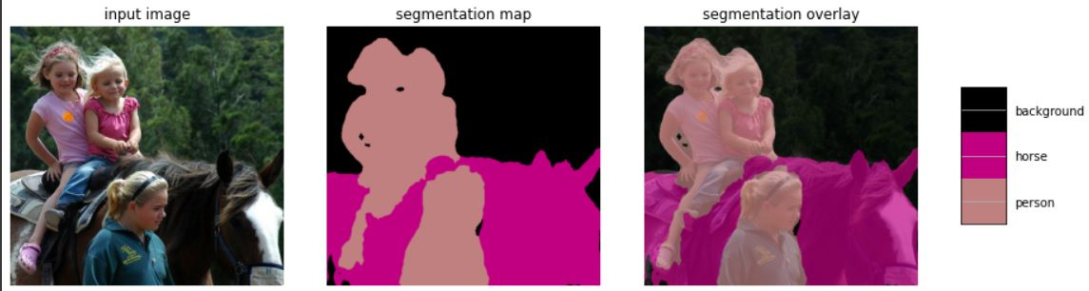
RESULT
The above image shows the analysis of image recognition

Slide 7
CONCLUSION
Our method has good generalization performance on other recognition tasks. Our model shows the image recognition baseline results .
We adopt Faster R-CNN as the detection method. Here we are interested in the improvements of replacing Imagenet with ResNet-101.
The detection implementation of using both models is the same, so the gains can only be attributed to better networks.

Slide 8

THANK YOU

